Slide 1


Machine Learning with Python
By ​
Arun Panayappan​

Slide 2


Slide 3


Slide 4
Agenda
Introduction to Machine Learning
Introduction to Python
Math for ML
Linear Regression
Logistic Regression

Slide 5
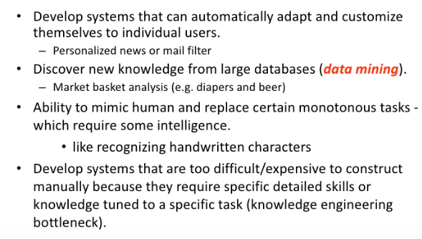
Why Machine Learning

Slide 6
Why Now?
Flood of data available (especially with the advent of the internet)
Increasing computation power
Growing progress in available algorithms and theory developed by researchers
Increasing support from industries

Slide 7


Some Sample Applications
Amazon product recommendations
Siri, Google Now
Text to speech, translations
Image recognition
Chatbots

Slide 8
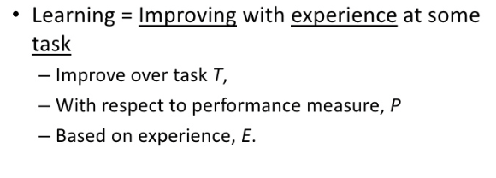
How Does A Machine Learn?

Slide 9
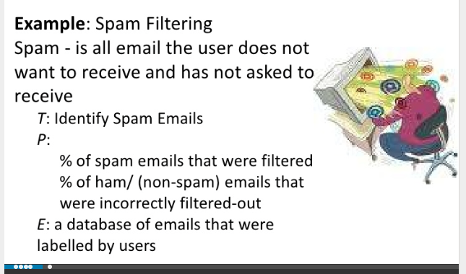
Simple Machine Learning Example

Slide 10
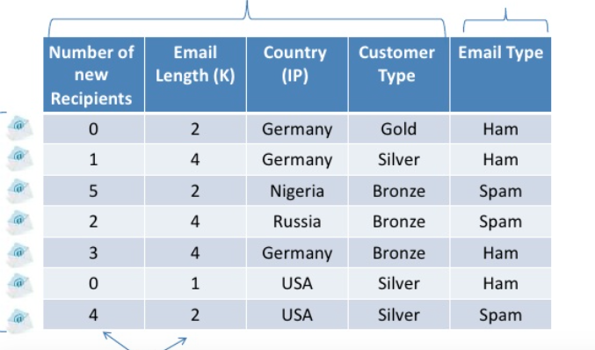
Preprocess Data

Slide 11
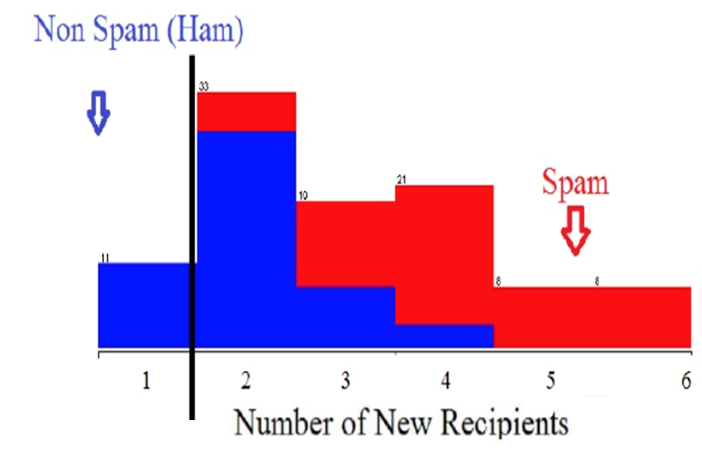
Spam Classifier

Slide 12
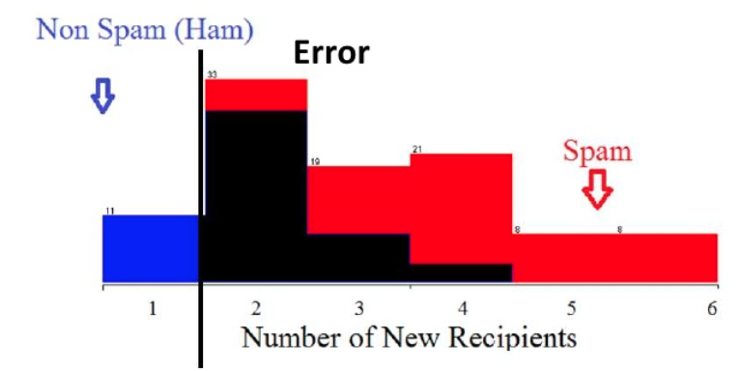
Spam Classifier

Slide 13
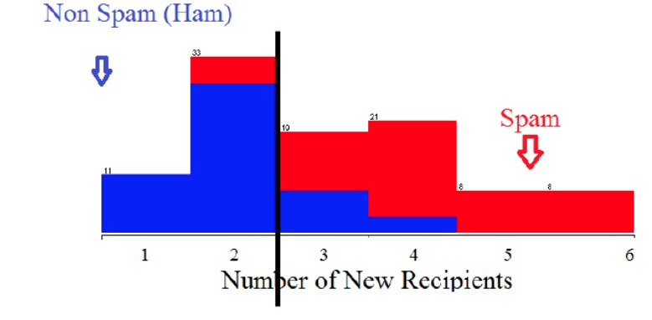
Spam Classifier

Slide 14
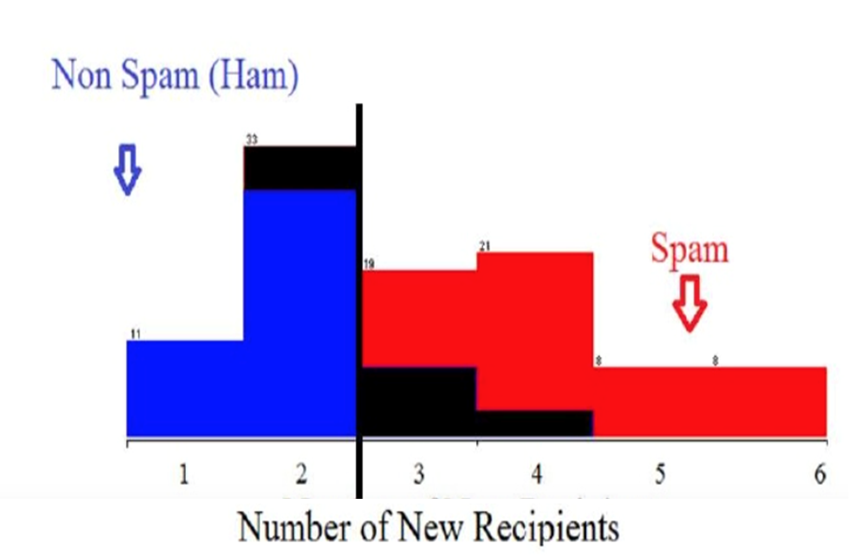
Spam Classifier

Slide 15
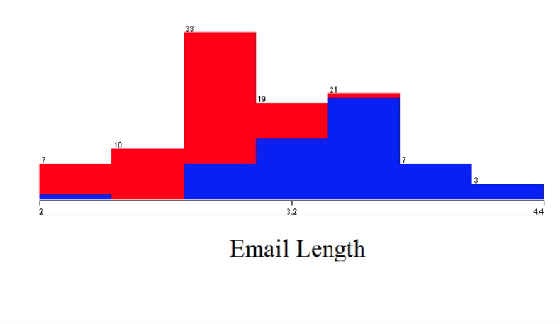
Spam Classifier

Slide 16
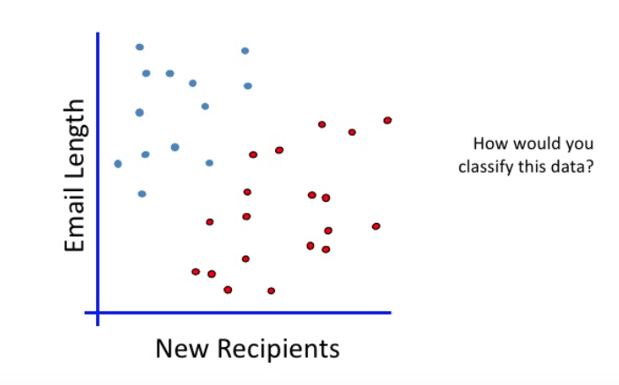
Linear Classifier

Slide 17
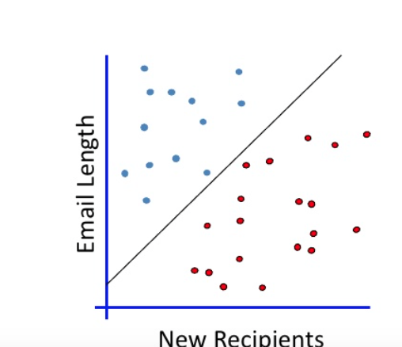
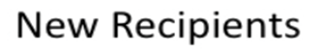
Best Fit Line

Slide 18
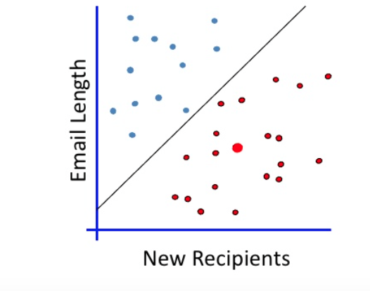
When A New Email Is Sent

Slide 19
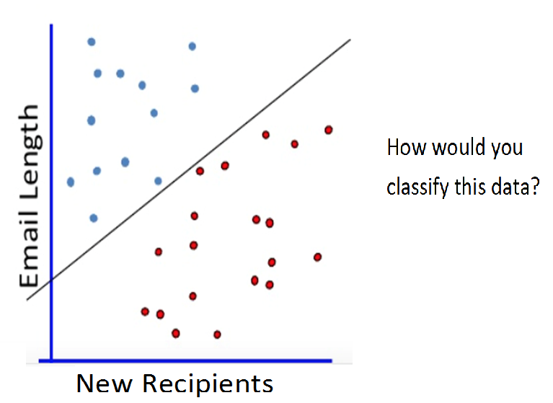
Which Is The Right Line?

Slide 20
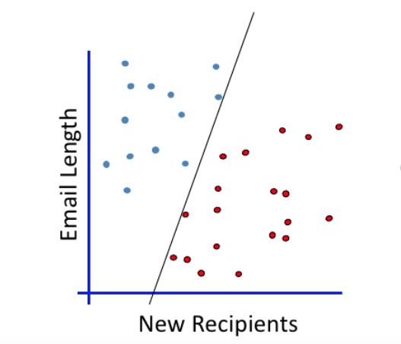
Which Is The Right Line?

Slide 21
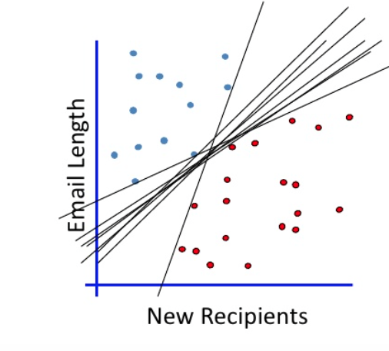
Which Is The Right Line?

Slide 22
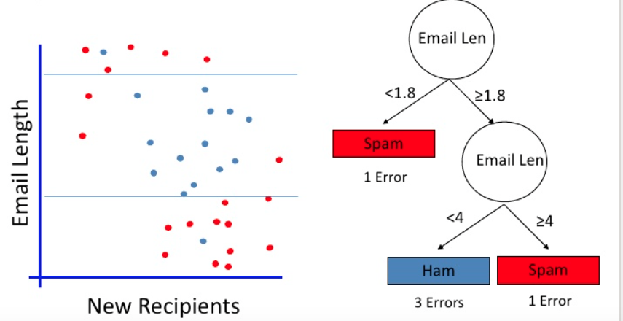
Sample Decision Tree

Slide 23

Classifier

Slide 24
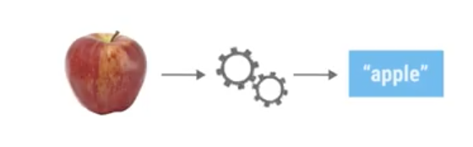
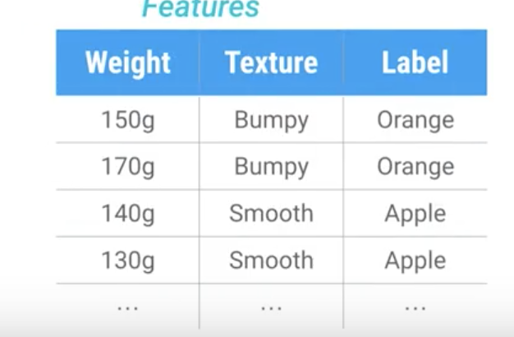
Data Set - Fruits

Slide 25
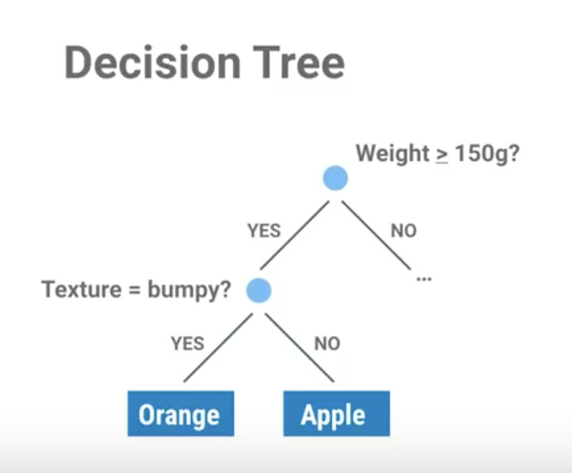
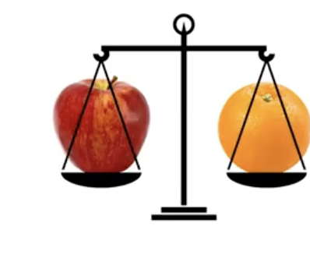
Decision Tree

Slide 26
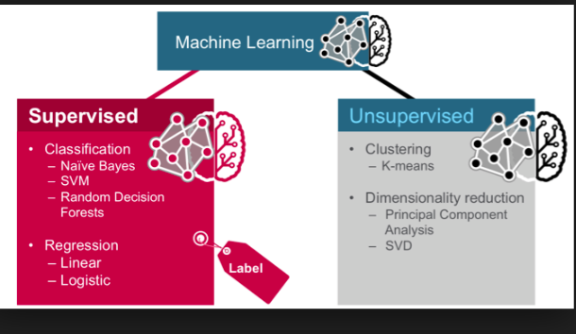
https://github.com/arunpa0206/mltraining

Slide 27
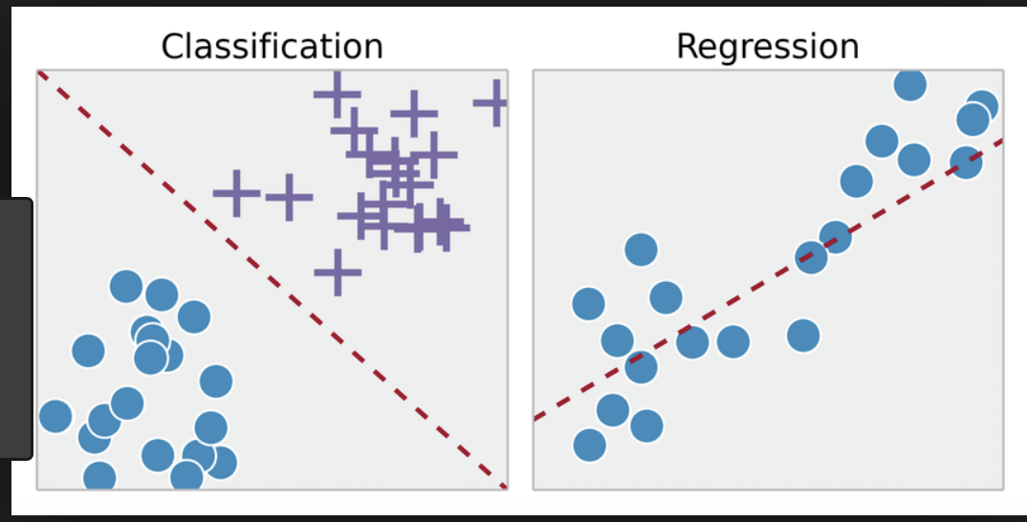
Regression vs Classification

Slide 28
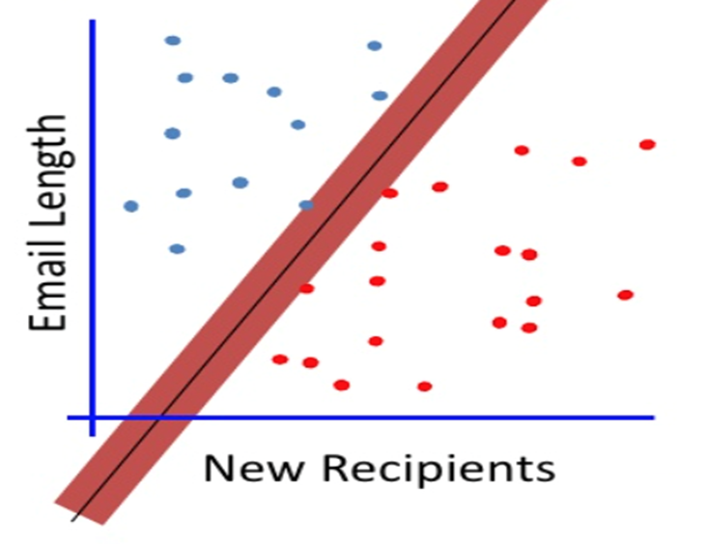
Maximum Margin

Slide 29
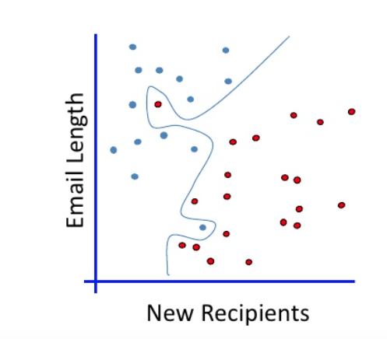
No Linear Classifier Fits This

Slide 30
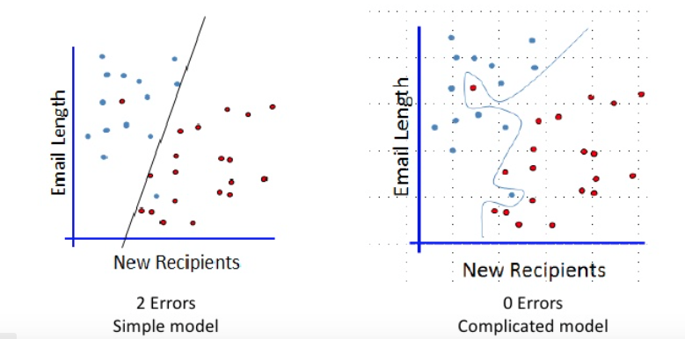
Which One?

Slide 31
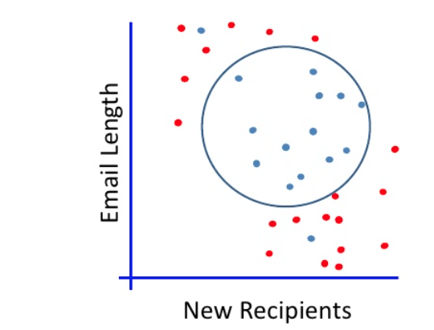
Non-Linear Separation

Slide 32
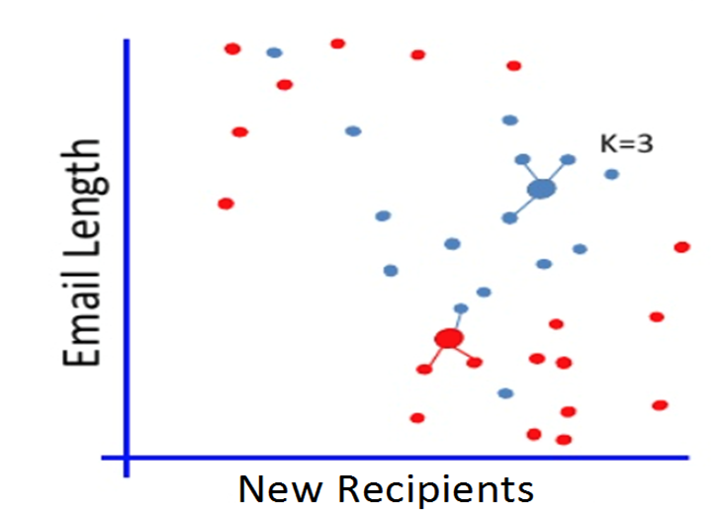
K-Nearest Neighbors

Slide 33
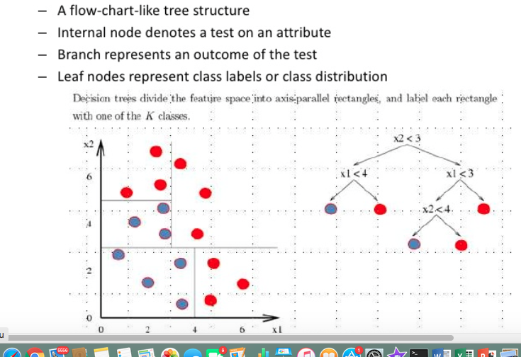
Decision Trees

Slide 34
Sample Decision Tree

Slide 35
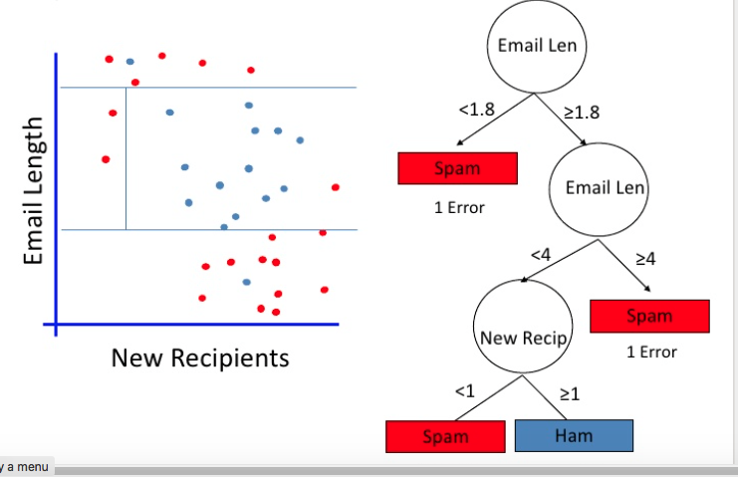
Decision Tree With Multiple Constraints

Slide 36
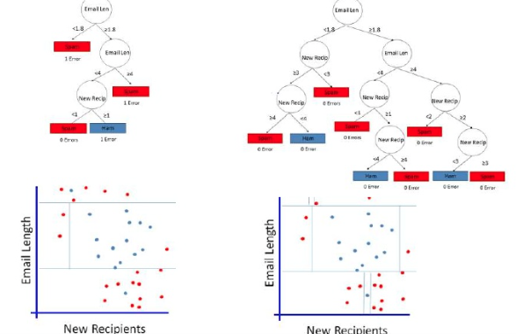
Which One?

Slide 37
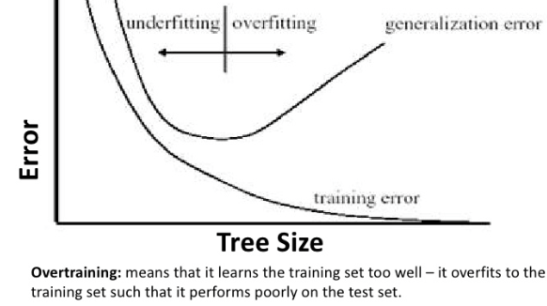
Overfitting And Under Fitting

Slide 38
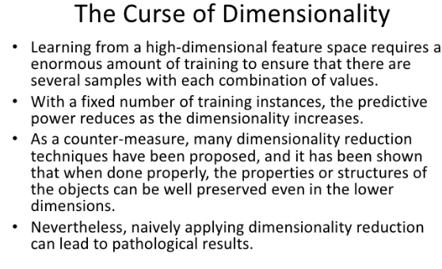
Less is More

Slide 39
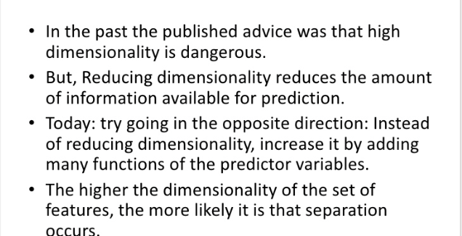
Less Is More – Not Any More

Slide 40
Introduction to Python

Slide 41
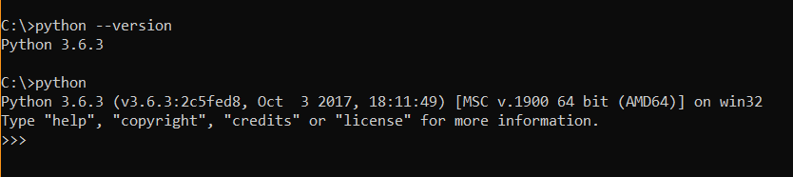
Step 1 - Starting with Python

Slide 42

Step 2 - Hello world Example

Slide 43
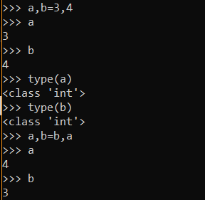
Step 3 – Variables

Slide 44
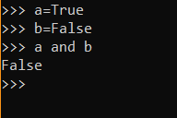
Step 4 – Logical Operator

Slide 45
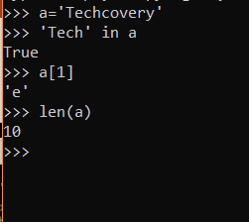
Step 5 - Strings

Slide 46
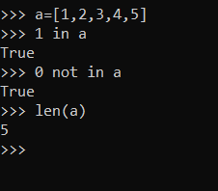
Step 6 - Lists

Slide 47
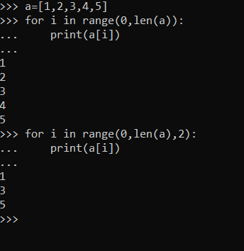
Step 7 – for Statement

Slide 48
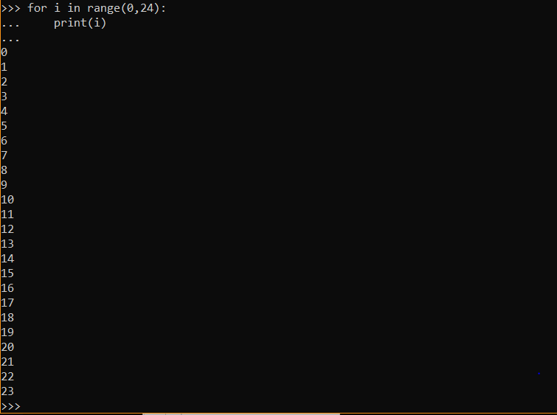
Step 8 – for Statement

Slide 49
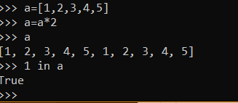
Step 9 – List Operators

Slide 50
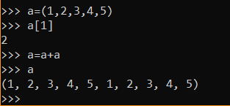
Step 10 - Tuples

Slide 51
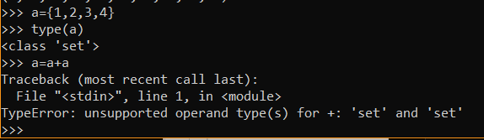
Step 11 - Set

Slide 52
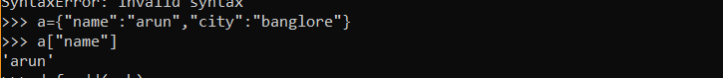
Step 12 - Dictionary

Slide 53
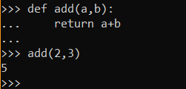
Step 13 - Functions

Slide 54
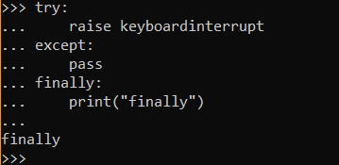
Step 14 - Exception

Slide 55
Python Numpy

Slide 56
Numpy – What is it?
A library to play with multi-dimensional arrays
It is Numerical Python
Numpy and Mathplotlib go hand in glove
This is a open source library

Slide 57
Installing ML Libraries Using Conda
https://www.davidculley.com/installing-python-on-a-mac/
https://conda.io/docs/user-guide/install/windows.html

Slide 58
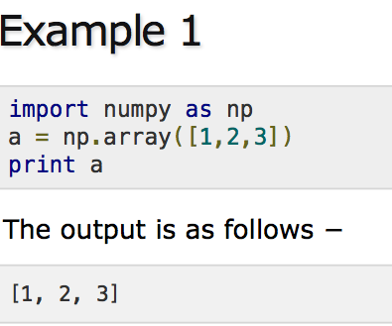
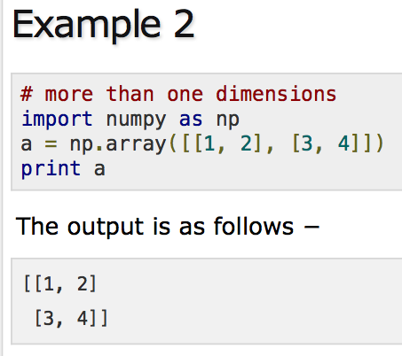
Numpy Examples - one Dimensional Two Dimensional Arrays

Slide 59
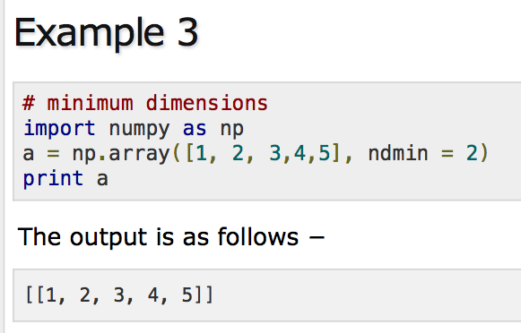
Numpy Examples - Set Dimensions

Slide 60

Numpy Examples - Set Data type

Slide 61


Numpy Arrays - Shape

Slide 62

Numpy Arrays And Examples - Reshape

Slide 63

Numpy Arrays - Range

Slide 64

Numpy Arrays With Multiple Dimensions - 3 Dimensional arrays

Slide 65
For More Examples On Numpy
https://www.tutorialspoint.com/numpy/numpy_array_from_existing_data.htm

Slide 66
Pandas

Slide 67
Pandas Overview
Used for data cleansing and analysis
Open source, low latency data processing
Used for econometrics of multidimensional data (Pandata)
Wes McKinney founded this in 2008

Slide 68

Key Features

Slide 69

Data Structures in Pandas

Slide 70

Series

Slide 71

Frames

Slide 72

Panels

Slide 73


Empty Series - Example

Slide 74

Pandas Indexing

Slide 75


Pandas – Series from dict

Slide 76

Pandas data frame representation

Slide 77

Create an empty data frame

Slide 78

Create data frames from lists

Slide 79

Dataframes with row indices

Slide 80

Reading From CSV

Slide 81

Selecting columns

Slide 82

Creating panels

Slide 83
Matplotlib overview

Slide 84


Example plot

Slide 85


Plot 2D graphs

Slide 86


Plotting with different styles

Slide 87
ML - Hello world
https://www.youtube.com/watch?v=cKxRvEZd3Mw

Slide 88
More examples
https://matplotlib.org/users/pyplot_tutorial.html

Slide 89
Linear Regression

Slide 90


Sample Data

Slide 91


Sample Data

Slide 92


Linear Algebra

Slide 93

Squared Error

Slide 94

Coefficient Of Determination

Slide 95

Low Variance And Positive Correlation

Slide 96

Low Variance And Negative Correlation

Slide 97
Math for ML

Slide 98

Mathematics for Machine Learning

Slide 99

Linear Algebra - Motivation

Slide 100

Motivation – Linear Algebra

Slide 101

Probability - Motivation

Slide 102

Random Samples

Slide 103

Statistics - Motivation

Slide 104

Measures of Variation

Slide 105


Geometry - Basics

Slide 106

Motivation - Calculus

Slide 107

Meaning of Derivative

Slide 108
Vector Basics

Slide 109

Vector Has Magnitude And Direction

Slide 110

Magnitude Of A Vector

Slide 111

Addition of two vectors

Slide 112

Subtraction of two vectors

Slide 113

Projection of a vector

Slide 114

Cosine and Dot product

Slide 115

Vector Dot Product

Slide 116

Vector – Space – NLP Example

Slide 117

Basis Vectors - Definition

Slide 118

Basis Vectors

Slide 119

Spanning Set of a vector space

Slide 120

Linearly dependent vectors

Slide 121
Matrices

Slide 122

Transformation

Slide 123

Matrix transformation of spaces

Slide 124

Matrix transformation of spaces

Slide 125

Determinant

Slide 126

Determinant of matrices
https://youtu.be/Ip3X9LOh2dk

Slide 127

Rotation Matrix

Slide 128

Composition of Matrix transforms

Slide 129

Rotation and Shear

Slide 130

Gauss Elimination

Slide 131

Inverse Matrix

Slide 132

Sparse Matrix Representation - Triplet method
Matrix contains more number of ZERO values than NON-ZERO values, such matrix is known as sparse matrix
Non-zero values along with their row and column index values
0th row stores total rows, total columns and total non-zero values in the matrix

Slide 133

Sparse Matrix Representation - Linked List
Row: Index of row, where non-zero element is located
Column: Index of column, where non-zero element is located
Value: Value of the non zero element located at index – (row,column)
Next node: Address of the next node

Slide 134
Why to use Sparse Matrix
Storage: There are lesser non-zero elements than zeros and thus lesser memory can be used
Computing time:Computing time can be saved by logically designing a data structure traversing only non-zero elements..

Slide 135
Application of Sparse matrix
Latent Semantic Analysis is a sparse matrix representation of the text
Calculation of the similarity between sparse customer behavior vectors using distance measures such as Euclidean distance or dot products

Slide 136


Singular Value Decomposition

Slide 137
Special matrices
Identity Matrix
Transpose Matrix
Symmetric and Skew Symmetric
Upper and Lower triangular
Orthogonal
Diagonal

Slide 138
Linear Mappings

Slide 139
Recap
https://www.youtube.com/watch?v=kYB8IZa5AuE&feature=youtu.be

Slide 140

Einstein Summation Convention

Slide 141

Non-square Matrix multiplication

Slide 142

Matrices to change basis

Slide 143

Transformation in changed basis

Slide 144

Orthogonal matrix

Slide 145

Rotation – Orthogonal transformation

Slide 146

The Gram – Schmidt Process

Slide 147

Gram Schmidt Process
Notes:
https://www.youtube.com/watch?v=rHonltF77zI

Slide 148
Gram schmidt Process - Use Cases
Unsupervised Feature selection Method
Heavily used in Text classification where there is large data
Selects unique set of orthonormal features
Achieves better performance than supervised Feature selection methods

Slide 149
Eigenvalues and Eigenvectors

Slide 150

EigenVector

Slide 151

A transformation

Slide 152

Axis of rotation of an object

Slide 153

Eigen Vector Definition

Slide 154

Uniform Scaling - Special eigen cases

Slide 155

Rotation - Special egien Cases

Slide 156

Horizontal shear and Vertical scaling

Slide 157

Diagonalization

Slide 158

Diagonal Matrix

Slide 159

Diagonalization

Slide 160
Computing Eigenvectors - Example

Slide 161

Step 1 - find mean of data

Slide 162


Step 2 - find Covariance Matrix
Calculate Co-variance matrix using the formula

Slide 163


Step 3 Find EigenValues
Calculate the eigenvalues using the formula

Slide 164

Step 3a - determinant Value

Slide 165

Step 4a : Solve for Eigenvectors

Slide 166

Step 4b - Calculate Eigenvectors

Slide 167

Changing to Eigen Basis

Slide 168

Change of basis

Slide 169
Feature Engineering

Slide 170
What is Feature Engineering
Domain knowledge of the data to create features
Increases the predictive power of machine learning algorithms
Creating features from raw data that help facilitate the machine learning process

Slide 171

Feature vector for real world problem

Slide 172

Feature Engineering cycle

Slide 173
Why is Feature Engineering hard
Powerful feature transformations can introduce leakage when applied wrong
Usually requires domain knowledge
Time-consuming , need to run thousand of experiments

Slide 174
Data Cleaning
Data contains missing values often encoded as Blanks, NaNs or other place holders
Price of losing data might be valuable
Basic strategies to infer them are:
Mean
Median
Mode
Using Models

Slide 175

Rounding
Retain most significant feature of data
Some times too much precision is just noise
Rounded variables can be treated as categorical variables

Slide 176

Binarization
Transform discrete or continous numeric features into binary features

Slide 177
Scalling
Models that are smooth functions of inputs are sensitive to scale
Scale numerical values into certain range
Popular techniques
Max-Min scaling
Standard z scaling

Slide 178

Max-Min Scalling
Squeezes all the values between the range of 0 to 1

Slide 179

Standard Z Scalling
After Standardizations Features have the mean of 0 and Variance of 1

Slide 180

Rolling Window
Summary statistics across the values can be features in our dataset
Uses the mean of the previous two values to predict the next value
Pandas provides a rolling() function that creates a new data structure

Slide 181

Moving Average
Process of converting raw timeseries into a timeseries of average scores
Recent values are given more weight vs older values.
Determining the expected feature value of raw data, the machine can more easily infer correlation

Slide 182
Principal Component Analysis

Slide 183

Problem Setting

Slide 184

Finding Coordinates of projected data

Slide 185

PCA - Data points

Slide 186


Slide 187


Slide 188


Slide 189

Step 5 - transform the samples
Eigenvectors with the lowest eigenvalues bear the least information so we eliminate EigenVector corresponding to lowest eigenvalues
Transform our samples onto the new subspace via the equation y = W′ × x where W′ is the transpose of the matrix W

Slide 190

PCA in higher Dimension

Slide 191

Recursive feature elimination
Recursively removes features, builds a model using the remaining attributes
Removes the weakest feature until the specified number of features is reached
Features are ranked by the model’s coef_ or feature_importances

Slide 192

LDA
New feature space to project the data in order to maximize classes separability
LDA takes labeling into account
Distance between data points of different categories after projection are more significant
Distance between the data points of the same class are more compact

Slide 193
LDA Explained
https://www.youtube.com/watch?v=azXCzI57Yfc

Slide 194
Calculus for ML

Slide 195

Fundamental theorem of Calculus

Slide 196
Fundamental theorem of Calculus
https://youtu.be/WUvTyaaNkzM

Slide 197

Multivariate functions
Input is made up of multiple numbers
Associating points in one space with points in another space

Slide 198

Definition of derivative

Slide 199

Power Rule
The Power rule tells us how to differentiate expressions of the form x^n

Slide 200

What is Chain Rule

Slide 201

Chain rule
https://youtu.be/YG15m2VwSjA?t=540

Slide 202

Multivariate Chain Rule

Slide 203

Second Order Derivative
Measures how the rate of change of a quantity is itself changing
Derivative of the derivative of the given function
Describes how the slope changes over the independent variable

Slide 204

Differential Equation
states how a rate of change (a "differential") in one variable is related to other variables

Slide 205

Partial Derivatives
Defined as derivatives of a function of multiple variables when all but the variable of interest are held fixed

Slide 206

Integration
When data is drawn probabilistically from a continuous space, then average values over the data are computed by integrals
Used in Determining the area under the curve

Slide 207

Taylor Series formula

Slide 208

Taylor Series
f(x) =3x3 + x2 – 8x + 6.

Slide 209

Taylor Series - Approximation

Slide 210


Taylor Series - Approximation

Slide 211
Use Cases - Taylor Series
Can be used to approximate a complex nonlinear relationship
The polynomial models is just the Taylor series expansion
Can be used where the relationship between study and explanatory variables is curvilinear

Slide 212

Polynomial Regression

Slide 213

Ridge regression

Slide 214

Scalar Vs Vector Vs Matrix Vs Tensor

Slide 215
Introduction to Tensor Calculus
Change in three or more dimensions involves Tensor Calculus
Extends the methods of calculus to tensors
Tensors are a generalization of matrices and are represented using n-dimensional arrays.

Slide 216
Introduction to optimization

Slide 217

Gradient
The gradient of a function f, denoted as ∇f, is the collection of all its partial derivatives into a vector
Represent the combination of rate of change in x,y,z at a given point in three or higher dimensional curve

Slide 218
Gradient
https://www.youtube.com/watch?v=tIpKfDc295M&list=PLSQl0a2vh4HC5feHa6Rc5c0wbRTx56nF7&index=19

Slide 219
Gradient Vector
Gradient vector points the direction of greatest rate of increase of f(x,y)
The matrix of partial derivatives of a scalar-valued function
Used to determine how directional derivatives at a point change as the direction changes,
https://www.youtube.com/watch?v=_-02ze7tf08&list=PLSQl0a2vh4HC5feHa6Rc5c0wbRTx56nF7&index=20

Slide 220

Directional Derivative
Rate at which the function changes at a point in the given direction
Directional derivative is taken along some vector in the input space
The directional derivative of f
along v,is the resulting rate of change in the output of the function

Slide 221

Partial Differentiation - Gradient

Slide 222

Hessian Matrix
The Hessian is a matrix of all possible Calculus second derivatives for a function
Used to determine if a value is a function minimum or a maximum or undetermined
Used to iteratively get closer and closer to a minimum error

Slide 223

Gradient Descent

Slide 224

Slope

Slide 225

Steps for GradientDescent

Slide 226

Newton Raphson method

Slide 227

Newton Raphson method

Slide 228

Newton Raphson Formula

Slide 229

Newton Raphson iteration 1

Slide 230

Newton Raphson iteration 2

Slide 231

Newton Raphson iteration 3

Slide 232

Newton Raphson Iteration 4
Used in Optimization algorithm
Objective of this method is to find better training directions

Slide 233
Steepest Gradient Descent
An algorithm for finding the nearest local minimum of a function
Special case of gradient descent where the step length is chosen to minimize the objective function value
https://www.youtube.com/watch?v=TEB2z7ZlRAw&t=7s

Slide 234

Lagrange Multipliers
Strategy for finding the local maxima and minima of a function
Allows us to maximize or minimize functions with the constraint
It helps to find an optimal point for a constrained optimization problem
Used to develop Support Vector Machine algorithm

Slide 235

Lagrange Multiplier
Notes:
https://medium.com/@andrew.chamberlain/a-simple-explanation-of-why-lagrange-multipliers-works-253e2cdcbf74

Slide 236

Lagrange Multipliers

Slide 237
Probability

Slide 238

Probability – Random Experiment

Slide 239

Sample space

Slide 240

Types of events

Slide 241

Independent Events

Slide 242
Probability Estimators
Sample statistics : A random variable whose value depends on which population item is included in sample
Sampling Variation : variation for sample statistics
Estimators : Statistics derived from sample too infer a population parameters
Estimate : value of estimators in particular sample

Slide 243

Conditional Probability

Slide 244

Bayes Theorem

Slide 245

Random Variable
Numerical description of the outcome of a statistical experiment
Random variable that may assume only a finite number values is said to be discrete
One that may assume any value in some interval on the real number line is said to be continuous

Slide 246


Probability Distribution Of Random variable
For discrete random variable, x, the probability distribution is defined by a probability mass function
For continuous random variable, x, the probability distribution is defined by a probability density function
The probability density function provides the height or value of the function at any particular value of x
Area under the graph of f(x) provides the probability that the variable
Notes:
https://www.britannica.com/science/statistics/Random-variables-and-probability-distributions

Slide 247


Probability trees

Slide 248

Disjoints
Two events are mutually exclusive if they cannot occur at the same time
If two events are disjoint, then the probability of them both occurring at the same time is 0.
Example - A football game can’t be held at the same time as a rugby game on the same field.

Slide 249

Addition Rule and Disjoint Events

Slide 250
Probability distribution

Slide 251

Probability Distribution

Slide 252


Normal Distribution

Slide 253

Binomial Distribution
Distribution that has two possible outcomes
Number of successes x in n repeated trials of a binomial experiment

Slide 254

Binomial Distribution Graph

Slide 255

Normal Vs Binomial Distribution
Binomial distribution
The discrete of the probability distribution number of successes in a sequence of N independent experiments
Tell us the probability for a specific number of “successes” to happen
Normal distribution
A continuous distribution, completely described by two parameters μand σ
The mean determines where the center of the distribution is located
The standard deviation determines the shape of the distribution

Slide 256

Poisson Distribution

Slide 257

Poisson Distribution Graph

Slide 258

Binomial Vs Poisson Distribution
Binomial :
Used to model number of success in a finite trails
Each trail has the same probability of success
Each trail has two possible outcomes
Poisson:
Used to model rates of occurrences of an event
The average number of events is constant
In poisson distribution mean = variance.

Slide 259

Normal Approximation To Binomial
when you use a continuous distribution (the normal distribution) to approximate a discrete distribution (the binomial distribution)
The number of observations n must be large enough
np and n(1 - p) should be greater than or equal to 10

Slide 260
Frequentists Vs Bayesian
Frequentists | Bayesian
Parameters are fixed | Data is fixed
Data varies | Parameters varies
Probability P(D|𝜃) | Likelihood P(𝜃|D)

Slide 261

Bayesian Inference
Used to update the probability for a hypothesis as more evidence or information becomes available
An important part of Bayesian Inference is the establishment of parameters and models
Models are the mathematical formulation of the observed events
Parameters are the factors in the models affecting the observed data

Slide 262


Likelihood Function
Notes:
Function of the parameters of a statistical model, given specific observed data
Probability describes the plausibility of a random outcome, without reference to any observed data
Likelihood describes the plausibility of a model parameter value, given specific observed data.

Slide 263

Prior & Posterior Belief distribution
Prior Belief distribution is used to represent our strengths on beliefs
Posterior Belief distribution is derived from multiplication of likelihood function & Prior Belief distribution.
As we collect more data, our posterior belief move towards prior belief from likelihood

Slide 264

Bayes factor
Ratio of the likelihood of one particular hypothesis to the likelihood of another
Measure of the strength of evidence in favor of one theory among two competing theories
Way to evaluate the data in favor of a null hypothesis, and to use external information to do so

Slide 265
Credible Interval
Interval within which an unobserved parameter value falls with a particular probability
Interval in the domain of a posterior probability distribution or a predictive distribution
The estimated parameter is treated as a random variable while the bounds are considered fixed

Slide 266

High Density Interval (HDI)
Indicates which points of a distribution are most credible
Formed from the posterior distribution after observing the new data
They are independent of intentions and sample size

Slide 267
Naïve Bayes

Slide 268

Conditional probability

Slide 269

Naïve Bayes Likelihood

Slide 270

Simple Case

Slide 271

Pros and cons

Slide 272
Statistics of datasets

Slide 273

Mean of a dataset

Slide 274

Median
The median is the middle number in a sorted, ascending or descending, list of numbers
sometimes used as opposed to the mean when there are outliers in the sequence

Slide 275

Mode
Number that appears most frequently in a set
The mode can be the same value as the mean and/or median

Slide 276

Standard Deviation
Measures the dispersion of a dataset relative to its mean
If the data points are further from the mean, there is a higher deviation within the data set

Slide 277

Variance of a dataset
Measurement of the spread between numbers in a data set
Measures how far each number in the set is from the mean and therefore from every other number in the set

Slide 278

Covariance Matrix
Covariance measures how much two random variables vary together
Defines the relationship in the entire dimensions as the relationships between every two random variables

Slide 279
Application Of Covariance Matrix
The covariance between variables in a data set can help reveal a lower dimension space
Data embedding
Dimensionality reduction
Feature extraction
Principal component analysis

Slide 280

Effect on mean and variance

Slide 281

Clustering

Slide 282

Decision Errors

Slide 283

Specificity
Referred to as the true negative rate (TNR)
Proportion of samples that test negative using the test in question that are genuinely negative
Highly specific test means that there are few false positive results

Slide 284
Sensitivity
Measures the proportion of actual positives that are correctly identified
The true positive rate (TPR) and is the proportion of samples that are genuinely positive
Test that correctly identifies all positive samples in a panel is very sensitive
Notes:
https://www.technologynetworks.com/analysis/articles/sensitivity-vs-specificity-318222

Slide 285

Precision and Recall

Slide 286

F1 Score

Slide 287

Bias and Variance
Bias
Type of error that occurs due to erroneous assumptions in the learning algorithm
High bias would cause an algorithm to miss relevant relations
This is sometimes referred to as underfitting
Variance
Type of error that occurs due to a model's sensitivity to small fluctuations in the training set
High variance would cause an algorithm to model the noise in the training set
This is most commonly referred to as overfitting.

Slide 288
Goodness of fit Test
Used to test if sample data fits a distribution from a certain population
Tells you if your sample data represents the data you would expect to find in the actual population
Establishes the discrepancy between the observed values

Slide 289

Hypothesis Testing
Act in statistics whereby an analyst tests an assumption regarding a population parameter
Test tells the analyst whether or not his primary hypothesis is true

Slide 290

Hypothesis testing

Slide 291

Probabilities

Slide 292

Example

Slide 293
Null Hypothesis and Alternate hypothesis
Null Hypothesis:
General statement or default position that there is no relationship between two measured phenomena
Denoted by H0
Alternate Hypothesis
Position that states something is happening, a new theory is true instead of an old one
Denoted by H1 or Ha,

Slide 294

Chi Square Test
Null hypothesis assumes that there is no significant difference between the observed and the expected value
The alternative hypothesis assumes that there is a significant difference between the observed and the expected value
Sample data is divided into intervals
Then the numbers of points that fall into the interval are compared
Notes:
https://www.statisticssolutions.com/chi-square-goodness-of-fit-test/

Slide 295

Chi square Test for Feature Selection
Measures how much the expected counts E and observed Count O deviate from each other.
Suppose you have a target variable and some other features that describes each sample of the data
we calculate chi-square statistics between every feature variable and the target variable
If the target variable is independent of the feature variable, we can discard that feature variable

Slide 296
Central Limit Theorem and Confidence Interval

Slide 297

Central Limit Theorem
Sampling distribution of the sample means approaches a normal distribution as the sample size gets larger
The average of your sample means will be the population mean
The average of all of the standard deviations in sample, will be equal to the actual standard deviation for your population

Slide 298

Central Limit Theorem

Slide 299

Sampling Variability
Indicates the range of values differs between samples
Extent to which the measures of a sample differ from the measure of the population
Gives us a sense of different the data are
Principle component analysis analyzes the differences between the sampling variability of specific measures to determine if there is a connection between variables

Slide 300

Confidence Interval
Describes the uncertainty associated with a sampling method.
Range around a measurement that conveys how precise the measurement is
Tells about how stable the estimate is
Probability that a value will fall between an upper and lower bound of a probability distribution

Slide 301

Confidence Interval example

Slide 302
Inference and Significance

Slide 303

Statistical Significance

Slide 304
Statistical SIgnificance
https://youtu.be/jLFeqQxGtOc

Slide 305

Statistical Significance t-Distribution

Slide 306

Right Tail Significance

Slide 307

2 Tailed significance

Slide 308

Practical SIgnificance

Slide 309

Non linear regression

Slide 310
Logistic Regression

Slide 311

Logit Function
Simply the logarithm of the odds: logit(x) = log(x / (1 – x))
used to model the probability of ‘success’ as a function of covariates

Slide 312
Odds Ratio
Quantifies the strength of the association between two events
Odds ratio represents the constant effect of a predictor X,
Odds = π/(1-π)
[p = proportional response, i.e. r out of n responded so π = r/n]

Slide 313

Logistic regression

Slide 314

Logistic regression

Slide 315


Logistic Regression

Slide 316

ROC Curve
The performance of a classification model at all classification thresholds
This curve plots two parameters:
True Positive Rate
False Positive Rate

Slide 317

AUC Curve - Example
AUC represents the probability that a random positive (green) example is positioned to the right of a random negative (red) example
A model whose predictions are 100% wrong has an AUC of 0.0; one whose predictions are 100% correct has an AUC of 1.0

Slide 318

Area Under the Curve
Measures the entire two-dimensional area underneath the entire ROC curve
AUC is as the probability that the model ranks a random positive example more highly than a random negative example

